Slide 1



ML_OPP’S Automation Script for Data Bank Activity.

Slide 2
Working Requirements:-
Install Python on All VM.
Install MySql, MongoDB(If Required) on All VM.
Workflow:-
Download Data from Production Side.
Run Script for Production_Downloaded_Data.
Store Downloaded Data in Data Base.
Create another CSV file for reference(If need to RolleBack the data).
ETL Concept used for Fetch the data for given requirements.

Slide 3
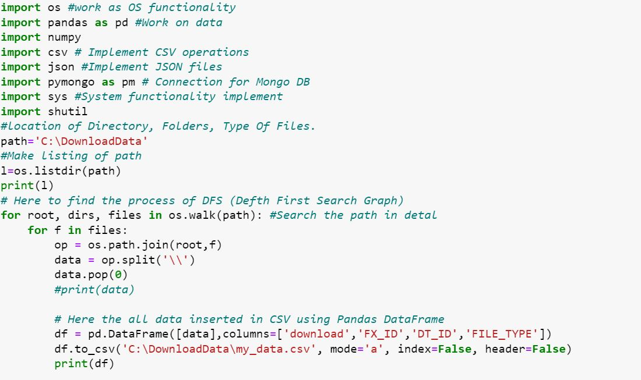
Python Script for list of folder data and store in CSV:-

Slide 4
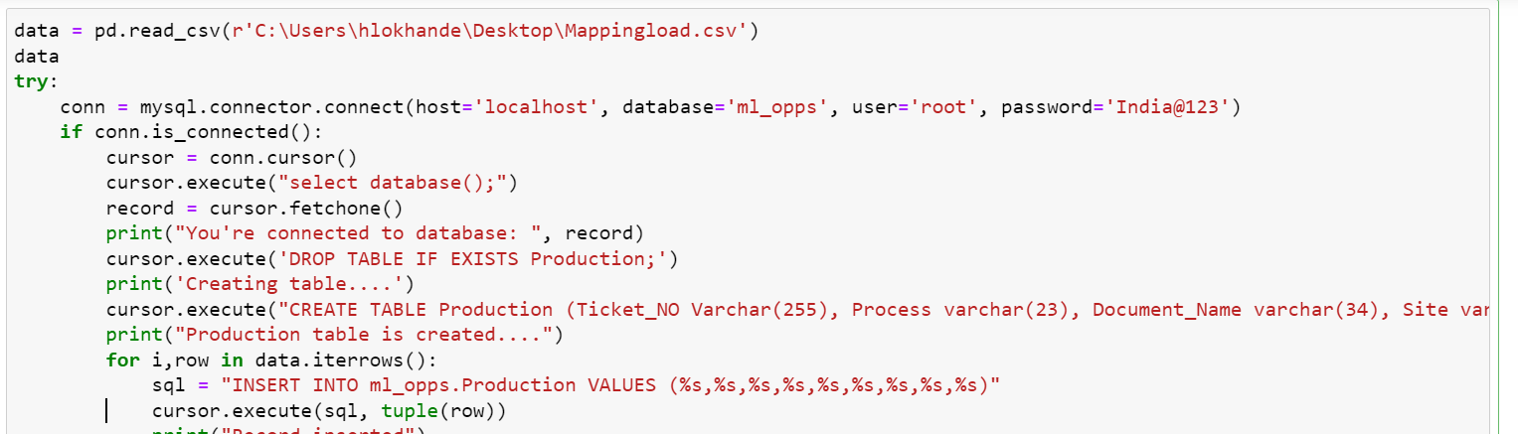
MYSql Data Base Connectivity Using Python:-

Slide 5
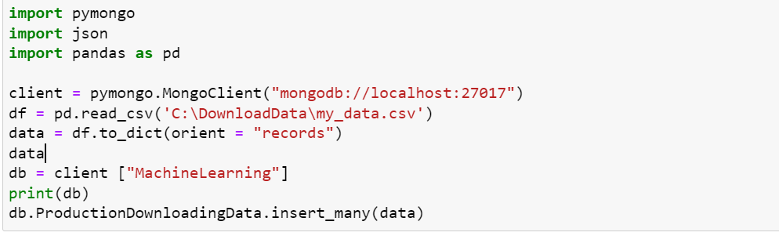
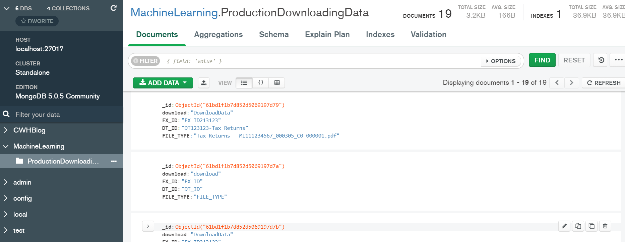
MongoDB Data Base Connectivity Using Python:-
Script using python for insert data in MongoDB.
Data Store in MongoDB.

Slide 6
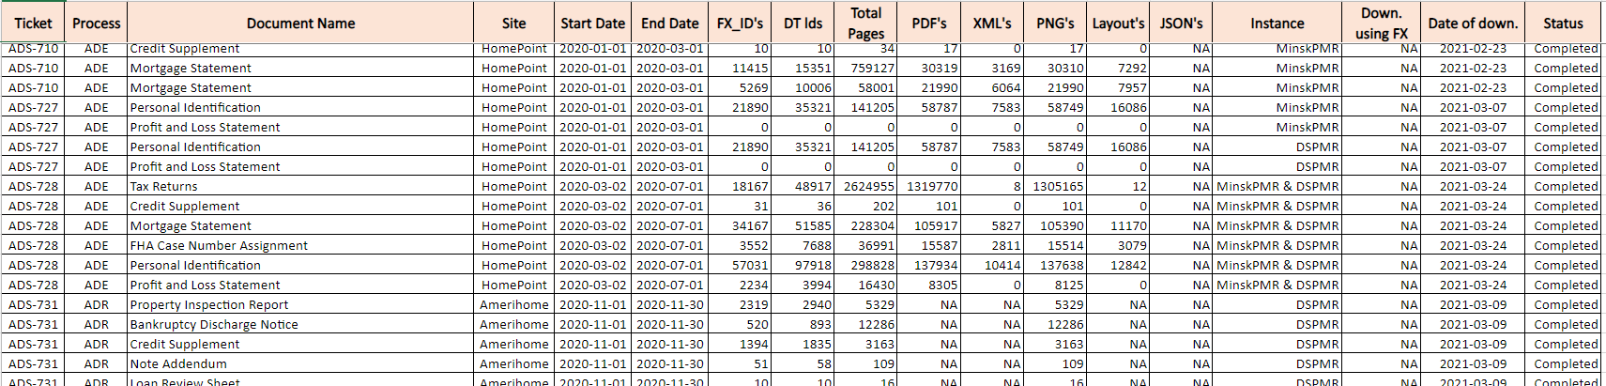
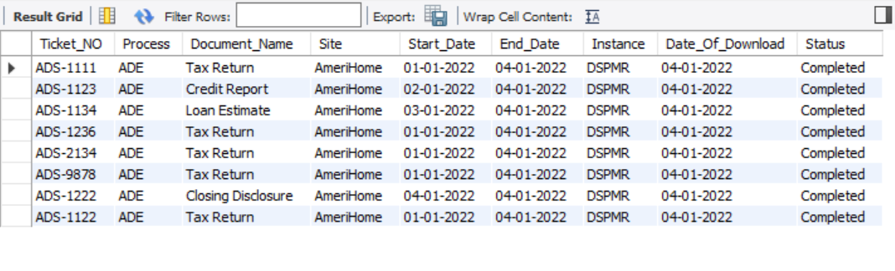
Flow of Data
Data available in Excel.(User insert data Manually)
Data Inserted In DataBase

Slide 7
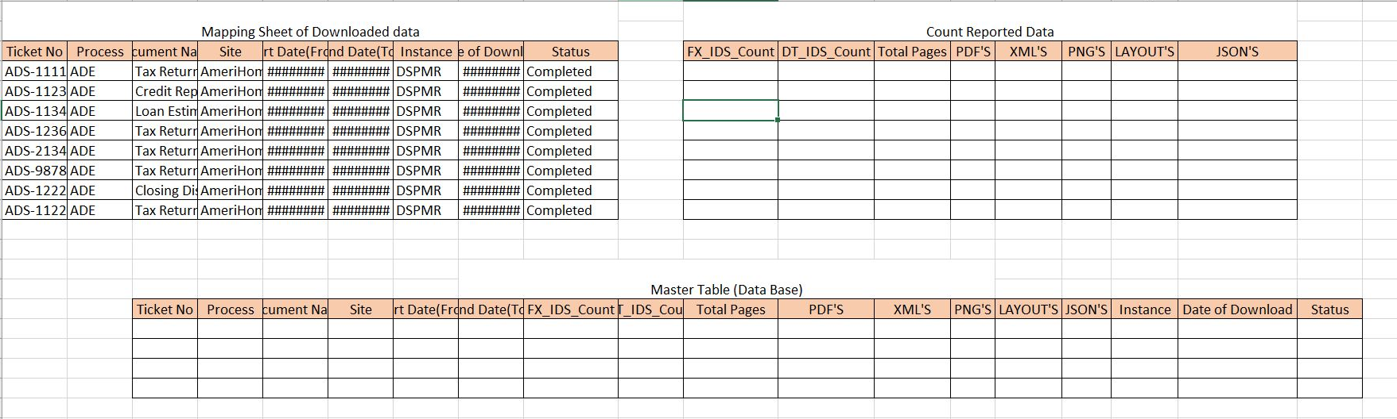
Real Workflow:-
Table created using Script

Slide 8
Source - Extraction
Stage - Transformation
Target - Load
Data Bank Workspace
Inventory
STG_PROC_INVENTORY.sql
STG_TBL_Inventory
SRC_TBL_Inventory
ADE
PY_GET_SNAPSHOT.py
SRC_TBL_ADE
STG_PROC_ADE.sql
STG_TBL_ADE
TGT_PROC_LOAD_INCRMT_SNAPSHOT.sql
ADR
SRC_TBL_ADR
STG_PROC_ADR.sql
STG_TBL_ADR
TGT_TBL_DATABANK_DLY_SNAPSHOT
Visualization
TGT_PROC_AGR_INCRMT_CNT_SUMMARY.sql
MST_TBL_JIRA_DETAILS
VW_REP_JIRA_STATUS_SUMMARY
STG_PROC_GET_MASTER_DATA
Load Master Data
VW_REP_MTD_DOC_PROCESSED
MST_TBL_PDF_PAGE_DETAILS
Tableau
Report
TGT_TBL_DATABANK_DLY_CNT_SNAPSHOT
VW_REP_PROCESSWISE_STATUS
VW_REP_CNT_SUMMARY
Physical Folder
on workspace
Table Name
View
Stored Procedure
Python Script

Slide 9
Source - Extraction
Stage - Transformation
Target - Load
Data Bank Workspace
Inventory
ADE
PY_GET_SNAPSHOT.py
SRC_TBL_PIPELINE
STG_PROC_ PIPELINE.sql
STG_TBL_ PIPELINE
TGT_PROC_LOAD_INCRMT_SNAPSHOT.sql
ADR
LOG.py
TGT_TBL_DATABANK_DLY_SNAPSHOT
MST_TBL_JIRA_DETAILS
TGT_PROC_AGR_INCRMT_CNT_SUMMARY.sql
STG_PROC_GET_MASTER_DATA
VW_REP_JIRA_STATUS_SUMMARY
Load Master Data
VW_REP_MTD_DOC_PROCESSED
MST_TBL_PDF_PAGE_DETAILS
Tableau
Report
TGT_TBL_DATABANK_DLY_CNT_SNAPSHOT
VW_REP_PROCESSWISE_STATUS
VW_REP_CNT_SUMMARY
MST_TBL_TRANS_LOGDETAIL
Visualization

